Slide 1
Real –Time Hand Tracking and Gesture Recognition for Human-Computer Interaction
Based on HUMODAN Project
Cristina Manresa, Javier Varona, Ramon Mas and Francisco J. Perales
Electronic Journal on Computer Vision and Image Analysis

Slide 2
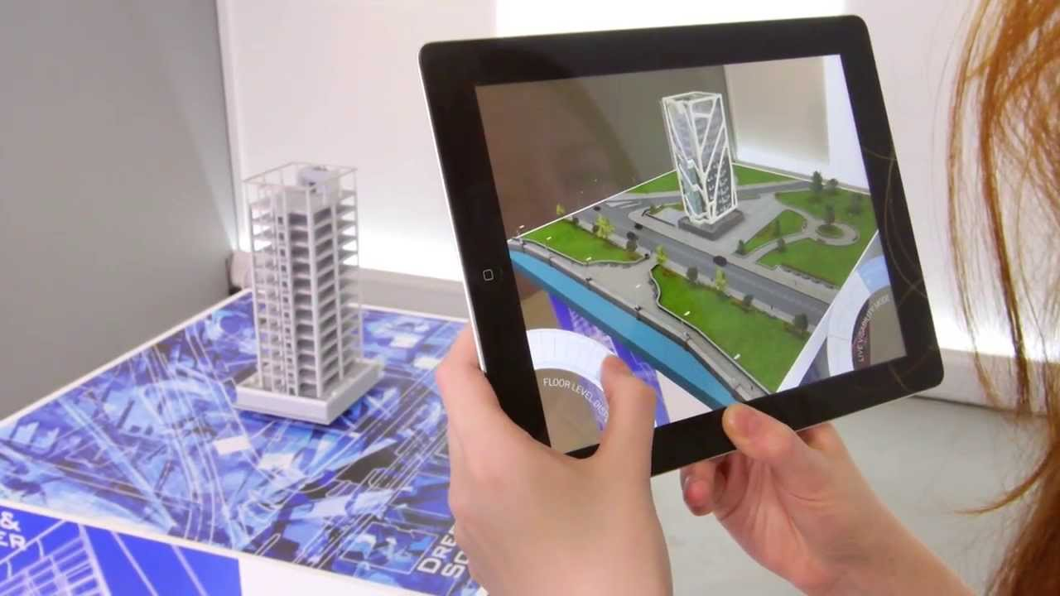
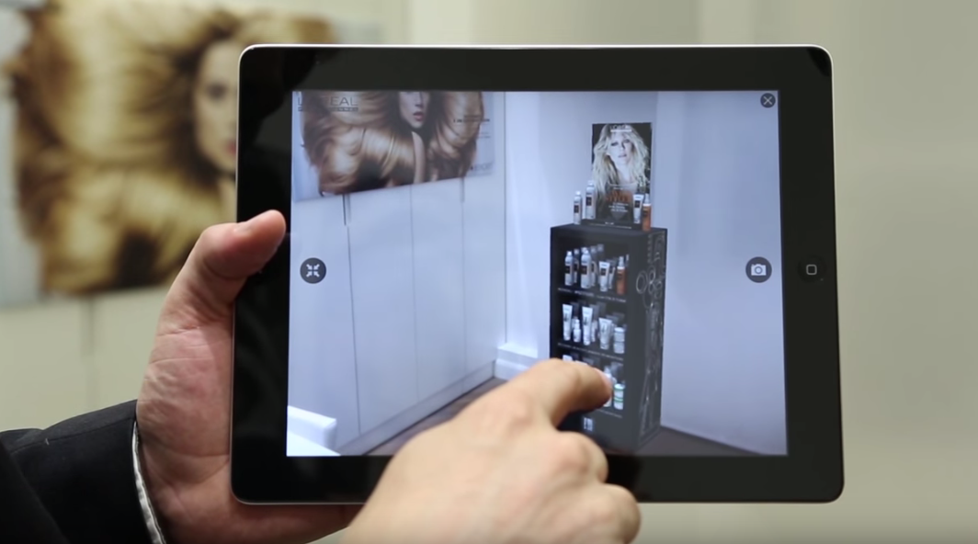
Why ?!! 1- Augmented Reality (AR)

Slide 3
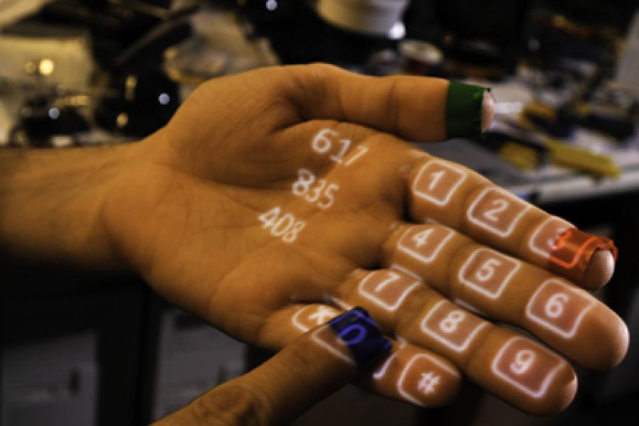
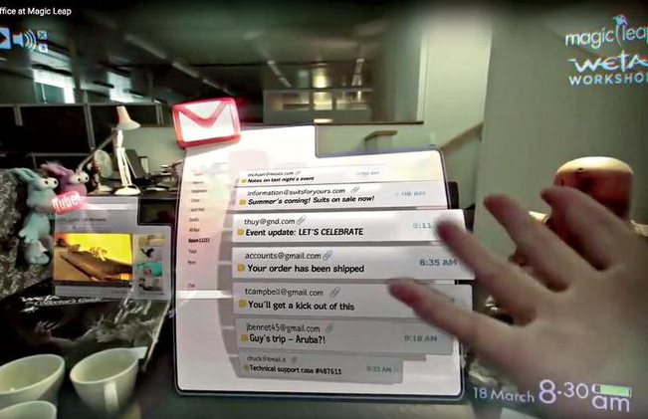
Why ?!! 2- Mixed Reality (MR)

Slide 4
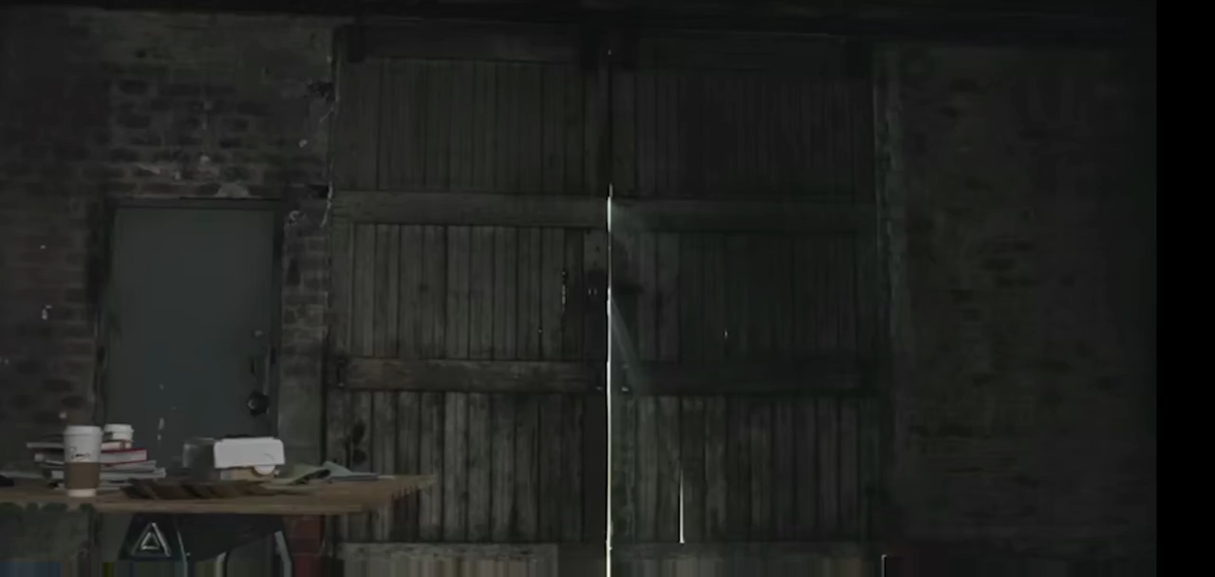

Slide 5
human-computer interaction (HCI)
Problem :
recognise human gestures in a natural way
measure the hand configuration in each time instant
Solution :
use of uniquely colored gloves or markers on hands or fingers
using a controlled background

Slide 6
Our Solution Characteristics
Low Resolution – Low Cost Webcam
Complex background
Real – time
gesture recognition

Slide 7
Steps :
1- Hand Segmentation
we choose skin-color as the hand feature
2- Hand Tracking
We use a pixel-based tracking for the temporal update of the hand state
3- Gesture Detection
we use the estimated hand state to extract several hand features

Slide 8
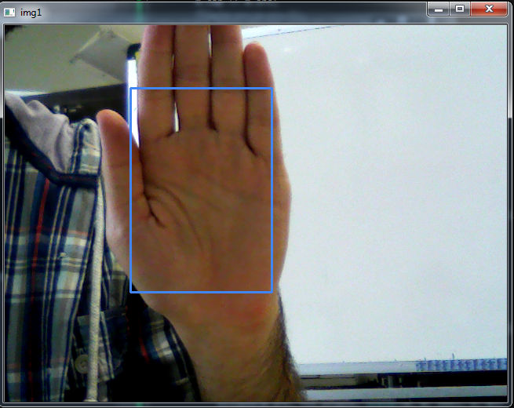
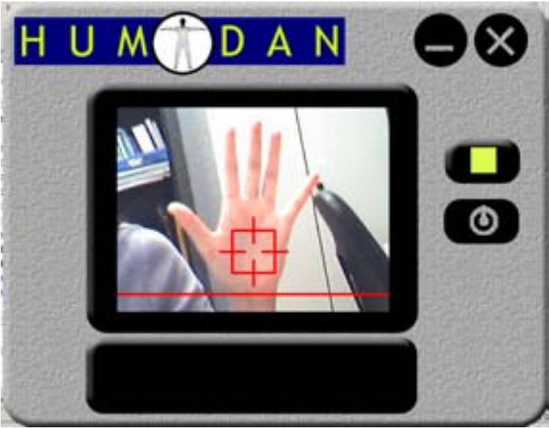
Hand Segmentation 1- Learning :

Slide 9
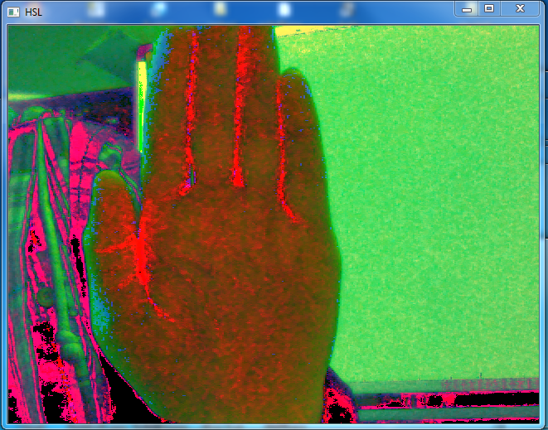
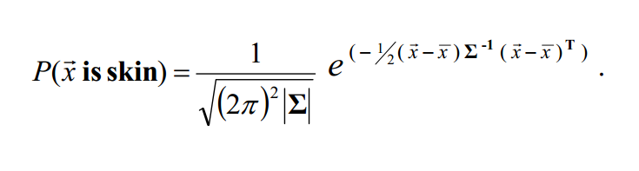
Hand Segmentation 1- Learning :
RGB-space to the HSL-space
Discarding saturation values near 0
Background Subtraction
cvtColor( InputArray src, OutputArray dst, int code = CV_HLS2BGR , int dstCn =0)

Slide 10
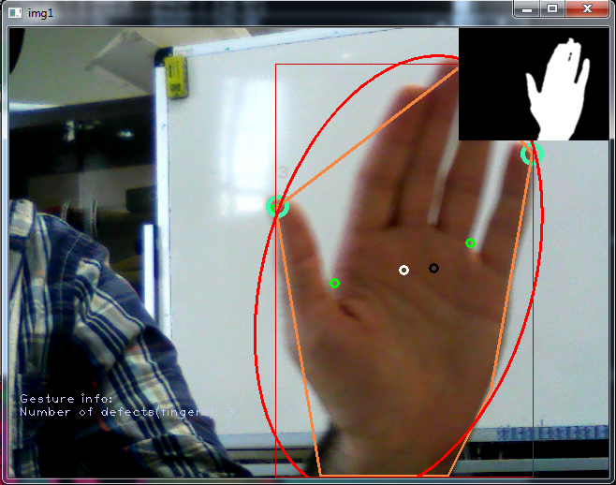
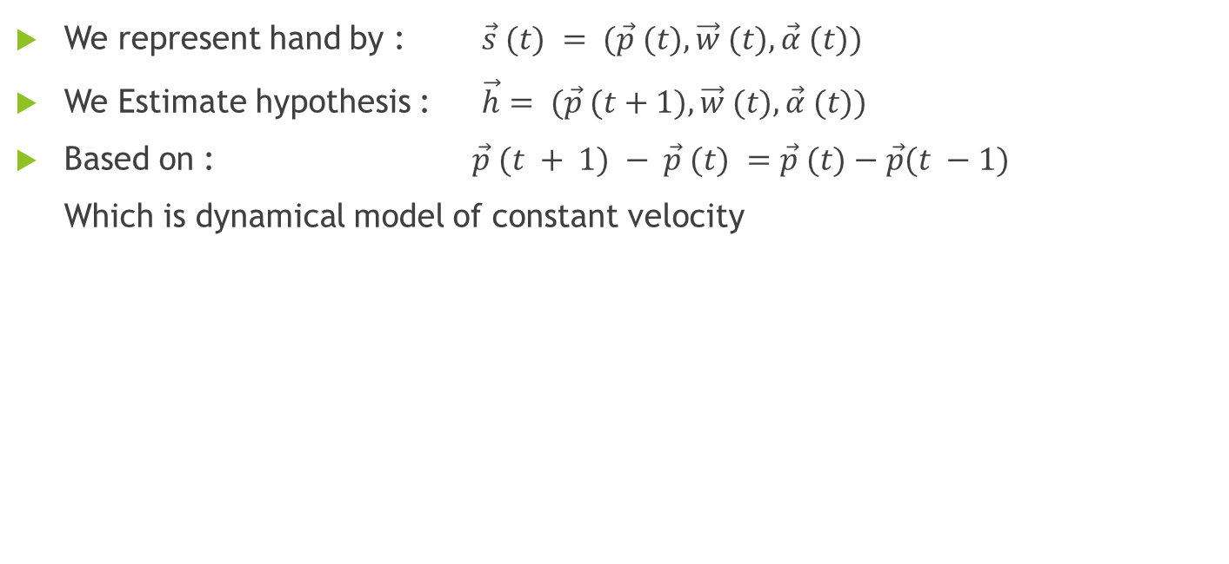
Hand Tracking
We represent hand by : $\vec{s} (t) = (\vec{p} (t), \vec{w} (t),\vec{α} (t))$
We Estimate hypothesis : $\vec{h}= (\vec{p} (t+1), \vec{w} (t),\vec{α} (t))$
Based on : $\vec{p} (t + 1) − \vec{p} (t) =\vec{p} (t)−\vec{p}(t −1)$
Which is dynamical model of constant velocity

Slide 11
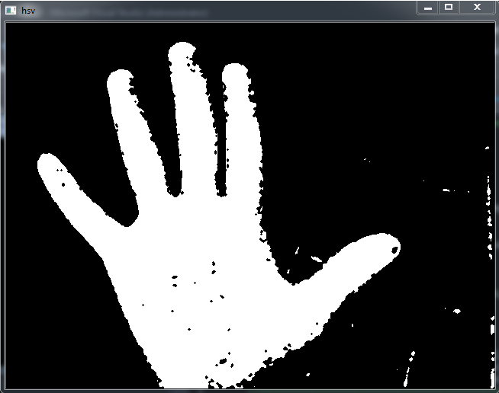
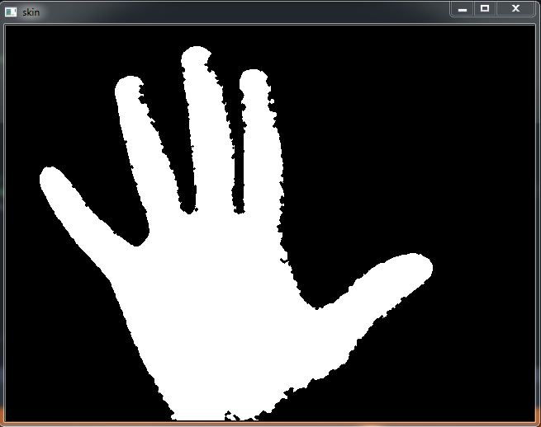
Blob Detection
Thresholding
Closing * 2
threshold( src_gray, dst, threshold_value, max_BINARY_value,threshold_type );
Mat Kernel = getStructuringElement(MORPH_ELLIPSE, Size(3, 3));
morphologyEx(HSL_cons_frame, HSL_cons_frame, MORPH_CLOSE, Kernel);

Slide 12
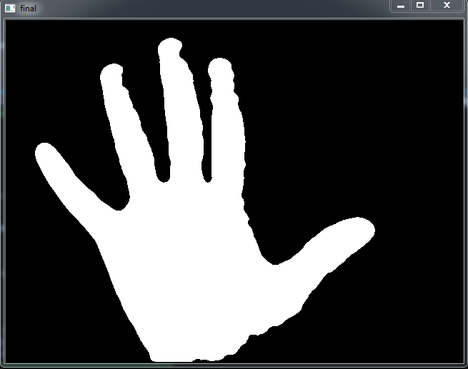
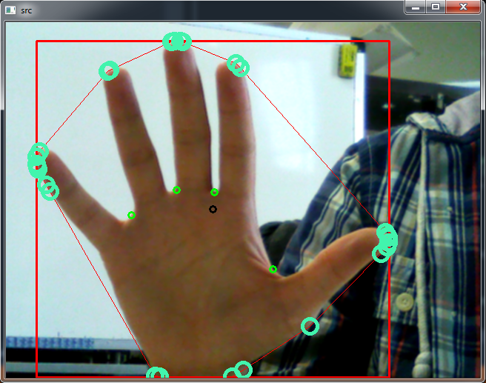
Blob Detection (continue)
Median filter(blur)
Find Contours
Select Biggest Contours
Convex hull
medianBlur(Src, Dst,size);
findContours(HSL_cons_frame, contours, hierarchy, RETR_EXTERNAL, CHAIN_APPROX_SIMPLE, Point(0, 0));
convexHull(Mat(contours[s]), Dst, false);

Slide 13
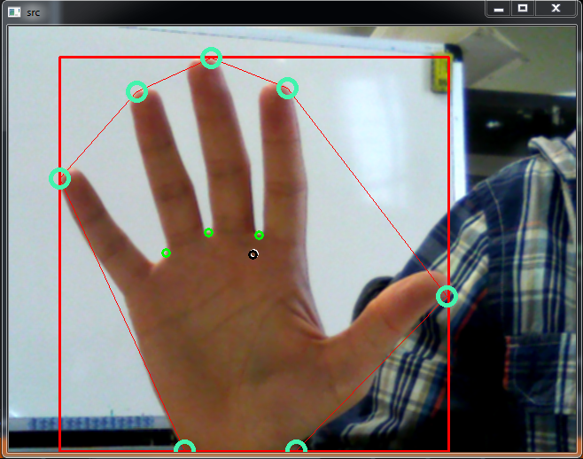
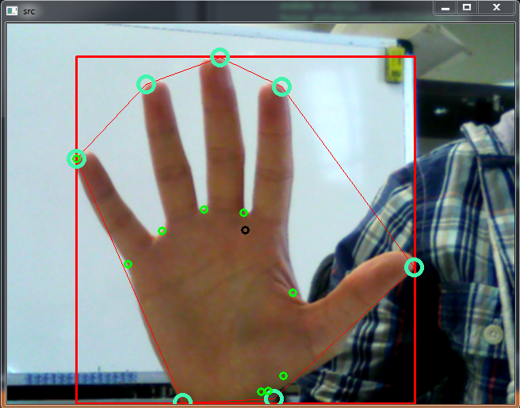
Blob Detection (continue)
Remove Redundant Convex points
(Douglas-Peucker algorithm)
Find Convexity Defects
approxPolyDP(Src, Dst, 18, true);
convexityDefects(contours, convexhull, defects);

Slide 14
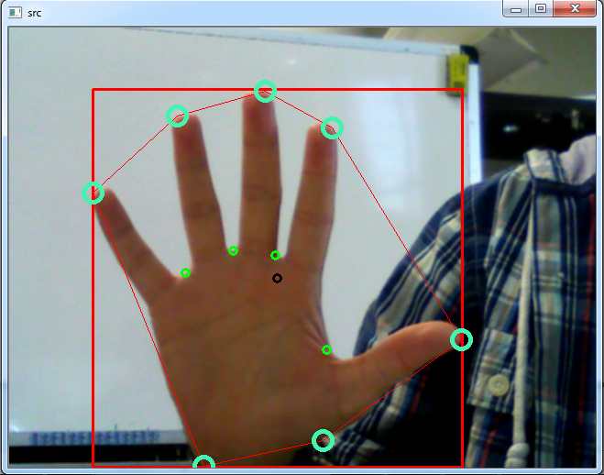
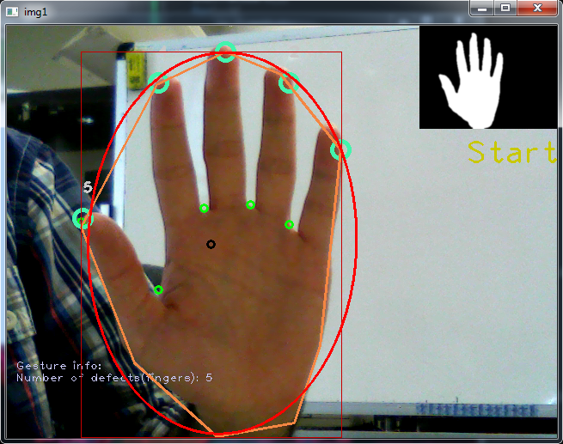
Blob Detection (continue)
Remove Redundant Convexity Defects
(My algorithm)
Find Bounding Ellipse
(Fitzgibbon algorithm)
And Rect
fitEllipse(points);

Slide 15
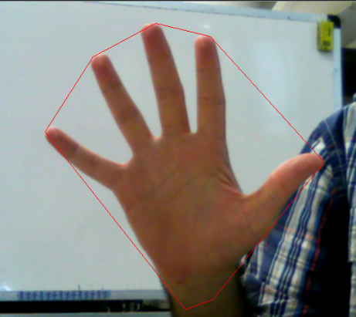
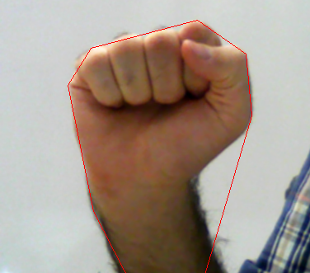
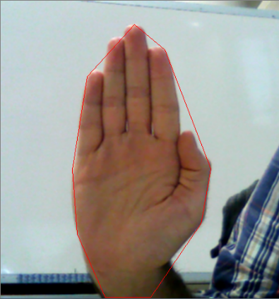
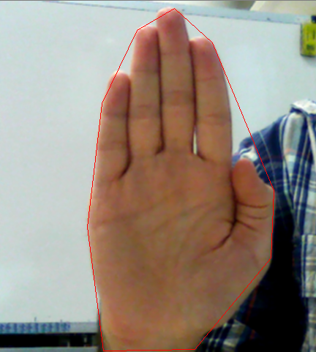
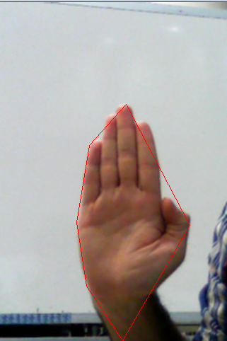
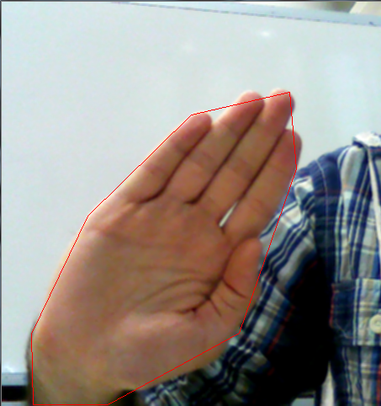
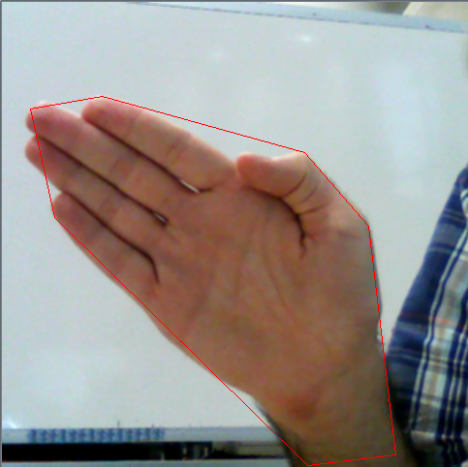
Gesture Detection
Start
Stop
Move
Front
Back
Right
Left

Slide 16
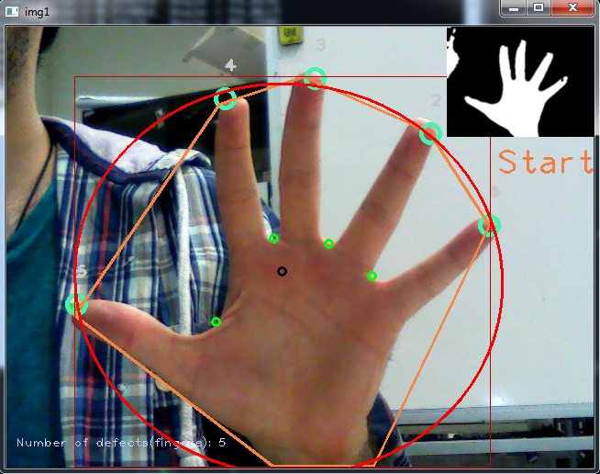
Gesture Detection (continue)
Start
1. All Defects are visible
2. All finger tips are visible
3. 185 > Angle of hand > 165
or 15 > Angle of hand > 0
4. Aspect Ratio of bounding
Rect is about 1

Slide 17
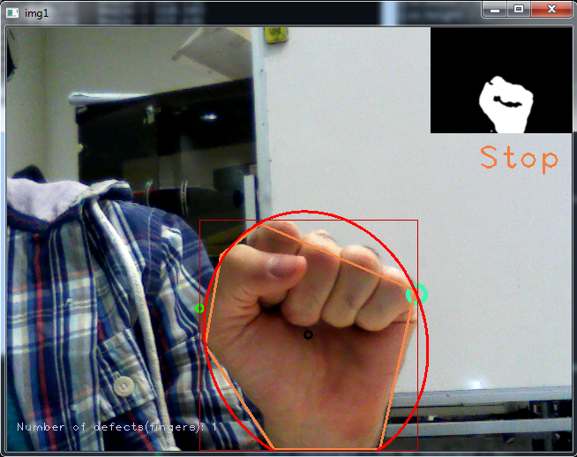
Gesture Detection (continue)
Stop
1. Number of Defects < 2
2. Number of Finger Tips < 2
3. 185 > Angle of hand > 165
or 15 > Angle of hand > 0
4. Aspect Ratio of bounding
Rect is between 1.1 to 1.6

Slide 18
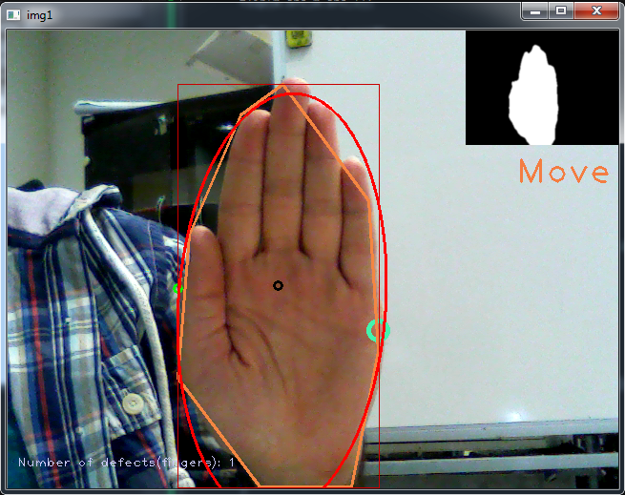
Gesture Detection (continue)
Move
1. Number of Defects < 2
2. Number of Finger Tips < 2
3. 185 > Angle of hand > 165
or 15 > Angle of hand > 0
4. Aspect Ratio of bounding
Rect > 2

Slide 19
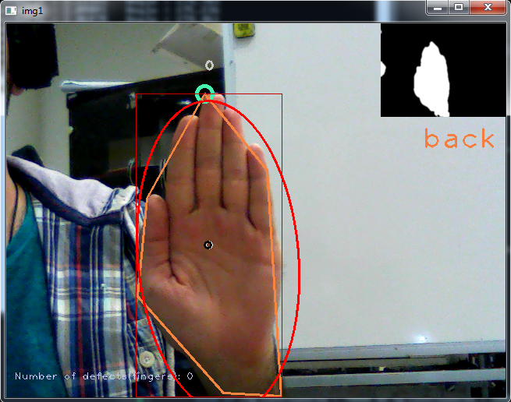
Gesture Detection (continue)
Back
1. Number of Defects < 2
2. Number of Finger Tips < 2
3. 185 > Angle of hand > 165
or 15 > Angle of hand > 0
4. Aspect Ratio of bounding
Rect > 2
5. Hand area is less than 50000
and has decreasing rate

Slide 20
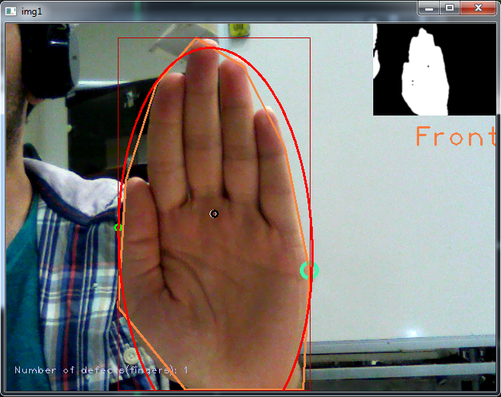
Gesture Detection (continue)
Back
1. Number of Defects < 2
2. Number of Finger Tips < 2
3. 185 > Angle of hand > 165
or 15 > Angle of hand > 0
4. Aspect Ratio of bounding
Rect > 2
5. Hand area is greater than 70000
and has increasing rate

Slide 21
Finally
You can access code and all of files and paper :
https://github.com/EmbeddedAndMore/Hand-Detection-and-Gesture- Recognition

